Slide 1
Key Management
public-key encryption helps address key distribution problems
have two aspects of this:
  distribution of public keys
  use of public-key encryption to distribute secret keys

Slide 2
Distribution of Public Keys
can be considered as using one of:
  Public announcement
  Publicly available directory
  Public-key authority
  Public-key certificates

Slide 3
Public Announcement
users distribute public keys to recipients or broadcast to community at large
  eg. append PGP keys to email messages or post to news groups or email list
major weakness is forgery
  anyone can create a key claiming to be someone else and broadcast it
  until forgery is discovered can masquerade as claimed user

Slide 4
Publicly Available Directory
can obtain greater security by registering keys with a public directory
directory must be trusted with properties:
  contains {name,public-key} entries
  participants register securely with directory
  participants can replace key at any time
  directory is periodically published
  directory can be accessed electronically
still vulnerable to tampering or forgery

Slide 5
Public-Key Authority
improve security by tightening control over distribution of keys from directory
has properties of directory
and requires users to know public key for the directory
then users interact with directory to obtain any desired public key securely
  does require real-time access to directory when keys are needed

Slide 6
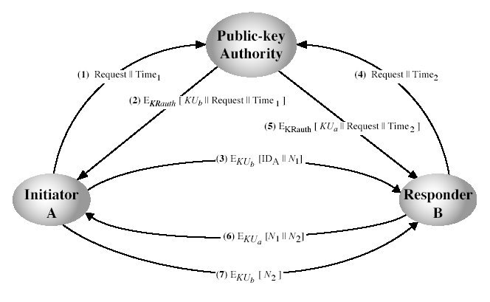
Public-Key Authority
Notes:
Stallings Fig 10.3. See text for details of steps in protocol.

Slide 7
Public-Key Certificates
certificates allow key exchange without real-time access to public-key authority
a certificate binds identity to public key
  usually with other info such as period of validity, rights of use etc
with all contents signed by a trusted Public-Key or Certificate Authority (CA)
can be verified by anyone who knows the public-key authorities public-key

Slide 8
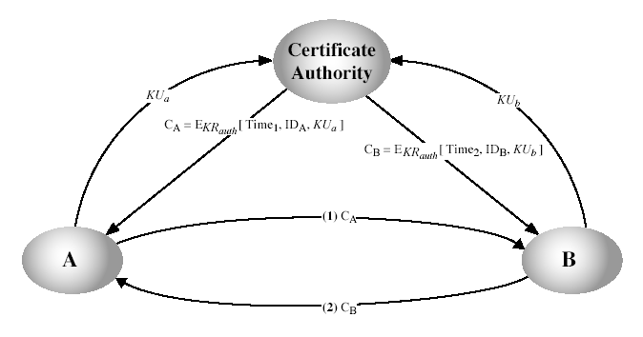
Public-Key Certificates
Notes:
Stallings Fig 10.4. See text for details of steps in protocol.

Slide 9
Public-Key Distribution of Secret Keys
use previous methods to obtain public-key
can use for secrecy or authentication
but public-key algorithms are slow
so usually want to use private-key encryption to protect message contents
hence need a session key
have several alternatives for negotiating a suitable session

Slide 10
Simple Secret Key Distribution
proposed by Merkle in 1979
  A generates a new temporary public key pair
  A sends B the public key and their identity
  B generates a session key K sends it to A encrypted using the supplied public key
  A decrypts the session key and both use
problem is that an opponent can intercept and impersonate both halves of protocol

Slide 11
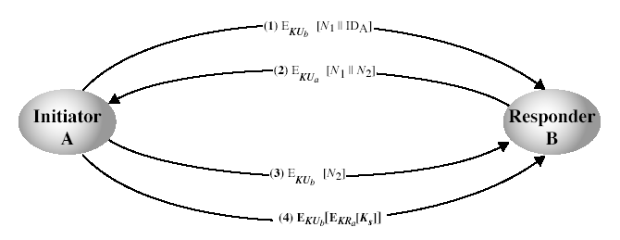
Public-Key Distribution of Secret Keys
if have securely exchanged public-keys:
Notes:
Stallings Fig 10.6. See text for details of steps in protocol. Note that these steps correspond to final 3 of Fig 10.3, hence can get both secret key exchange and authentication in a single protocol.

Slide 12
Diffie-Hellman Key Exchange
first public-key type scheme proposed
by Diffie & Hellman in 1976 along with the exposition of public key concepts
  note: now know that James Ellis (UK CESG) secretly proposed the concept in 1970
is a practical method for public exchange of a secret key
used in a number of commercial products
Notes:
The idea of public key schemes, and the first practical scheme, which was for key distribution only, was published in 1977 by Diffie & Hellman. The concept had been previously described in a classified report in 1970 by James Ellis (UK CESG) - and subsequently declassified in 1987. See History of Non-secret Encryption (at CESG).

Slide 13
Diffie-Hellman Key Exchange
a public-key distribution scheme
  cannot be used to exchange an arbitrary message
  rather it can establish a common key
  known only to the two participants
value of key depends on the participants (and their private and public key information)
based on exponentiation in a finite (Galois) field (modulo a prime or a polynomial) - easy
security relies on the difficulty of computing discrete logarithms (similar to factoring) – hard

Slide 14
Diffie-Hellman Setup
all users agree on global parameters:
  large prime integer or polynomial q
  α a primitive root mod q
each user (eg. A) generates their key
  chooses a secret key (number): x_{A} < q
  compute their public key: y_{A} = α^{xA} mod q
each user makes public that key y_{A}
Notes:
The prime q and primitive root α can be common to all using some instance of the D-H scheme. Note that the primitive root α is a number whose powers successively generate all the elements mod q. Alice and Bob choose random secrets x's, and then "protect" them using exponentiation to create the y's. For an attacker monitoring the exchange of the y's to recover either of the x's, they'd need to solve the discrete logarithm problem, which is hard.

Slide 15
Diffie-Hellman Key Exchange
shared session key for users A & B is K_{AB}:
  K_{AB} = α^{xA.xB} mod q
  = y_{A}^{xB} mod q (which B can compute)
  = y_{B}^{xA} mod q (which A can compute)
K_{AB} is used as session key in private-key encryption scheme between Alice and Bob
if Alice and Bob subsequently communicate, they will have the same key as before, unless they choose new public-keys
attacker needs an x, must solve discrete log
Notes:
The actual key exchange for either party consists of raising the others "public key' to power of their private key. The resulting number (or as much of as is necessary) is used as the key for a block cipher or other private key scheme. For an attacker to obtain the same value they need at least one of the secret numbers, which means solving a discrete log, which is computationally infeasible given large enough numbers

Slide 16
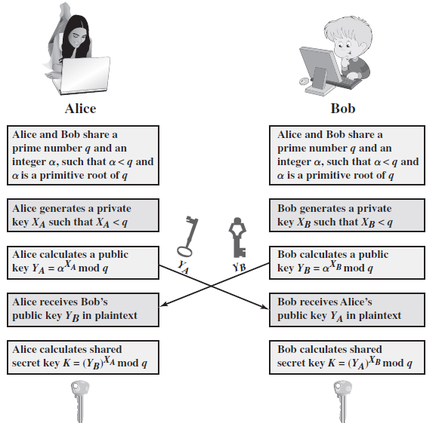

Slide 17
Diffie-Hellman Example
users Alice & Bob who wish to swap keys:
agree on prime q=353 and α=3
select random secret keys:
  A chooses x_{A}=97, B chooses x_{B}=233
compute public keys:
  y_{A}=3⁹⁷ mod 353 = 40 (Alice)
  y_{B}=3²³³ mod 353 = 248 (Bob)
compute shared session key as:
  K_{AB}= y_{B}^{xA} mod 353 = 248⁹⁷ = 160 (Alice)
  K_{AB}= y_{A}^{xB} mod 353 = 40²³³ = 160 (Bob)

Slide 18
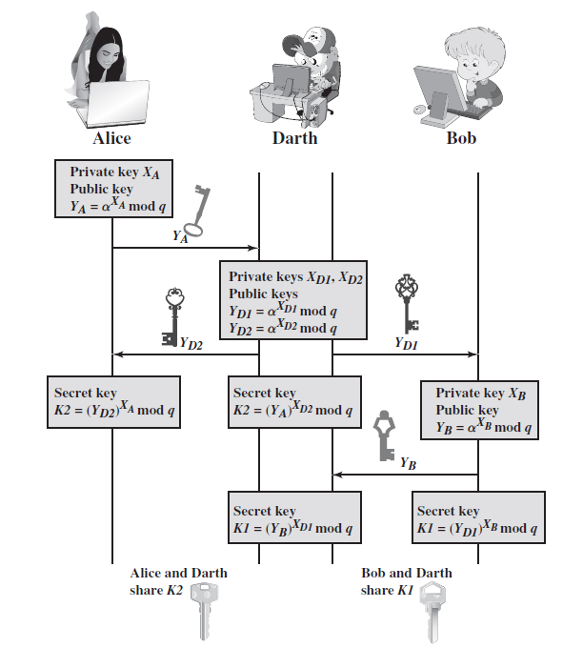
Man in the Middle Attack on Diffie Hellman
it nitk

Slide 19
Users A and B use the Diffie-Hellman key exchange technique with a common prime
Q = 71.
a. Find the primitive root ?
b. If user A has private key XA = 5, what is A’s public key YA?
c. If user B has private key XB = 12, what is B’s public key YB?
d. What is the shared secret key?

Slide 20
SOLUTION:
a. primitive root=7
b. YA = 75 mod 71= 51
c. YB = 712 mod 71= 4
d. K = 45 mod 71= 30

Slide 21
Consider a Diffie-Hellman scheme with a common prime q = 11 and a primitive root
a = 2.
a. Show that 2 is a primitive root of 11.
b. If user A has public key YA = 9, what is A’s private key XA?
c. If user B has public key YB = 3, what is the secret key K shared with A?

Slide 22
SOLUTION:
a. f(11) = 10
210 = 1024 = 1 mod 11
If you check 2n for n < 10, you will find that none of the values is 1 mod 11.
b. 6, because 26 mod 11 = 9
c. K = 36 mod 11= 3

Slide 23
Consider a man-in-the-middle attack on the Diffie-Hellman key exchange protocol in which the adversary generates two public–private key pairs for the attack. Could the same attack be accomplished with one pair? Explain.

Slide 24
1. Darth prepares for the attack by generating a random private key XD and then
computing the corresponding public key YD.
2. Alice transmits YA to Bob.
3. Darth intercepts YA and transmits YD to Bob. Darth also calculates
K2 = YA ( )XD modq
4. Bob receives YD and calculates K1= YD ( )XB modq .
5. Bob transmits YB to Alice
6. Darth intercepts YB and transmits YD to Alice. Darth calculates
K1= YB ( )XD modq.
7. Alice receives YD and calculates K2 = YD ( )XA modq .

